Slide 1
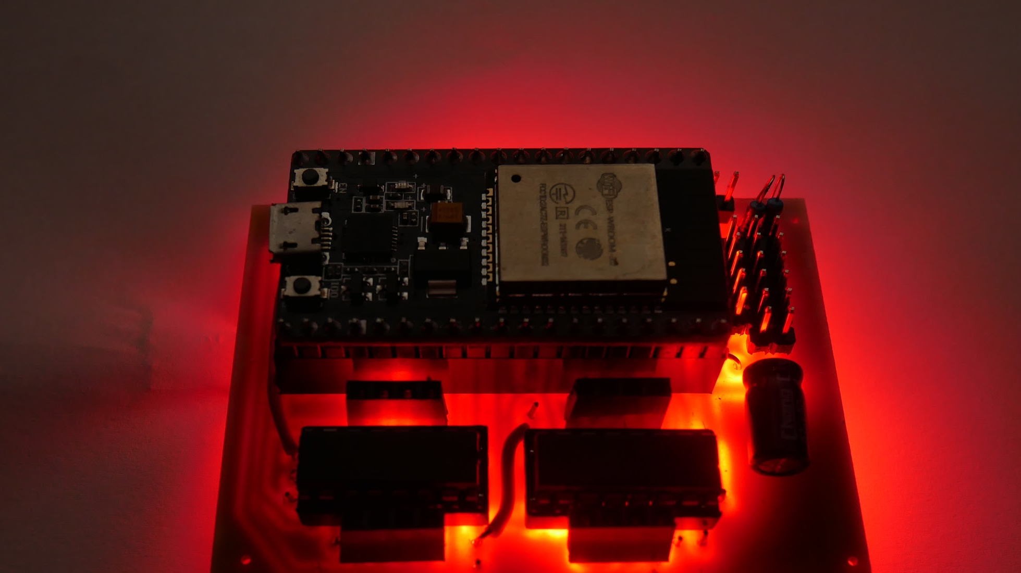
RCM Control System
Notes:
RCM stands for robot control module. I know it’s not a very creative name but it does fit the goal of making a single board have all the functions needed for controlling a robot. An RCM is supposed to make it relatively easy to build small robots that can be controlled over wifi.

Slide 2
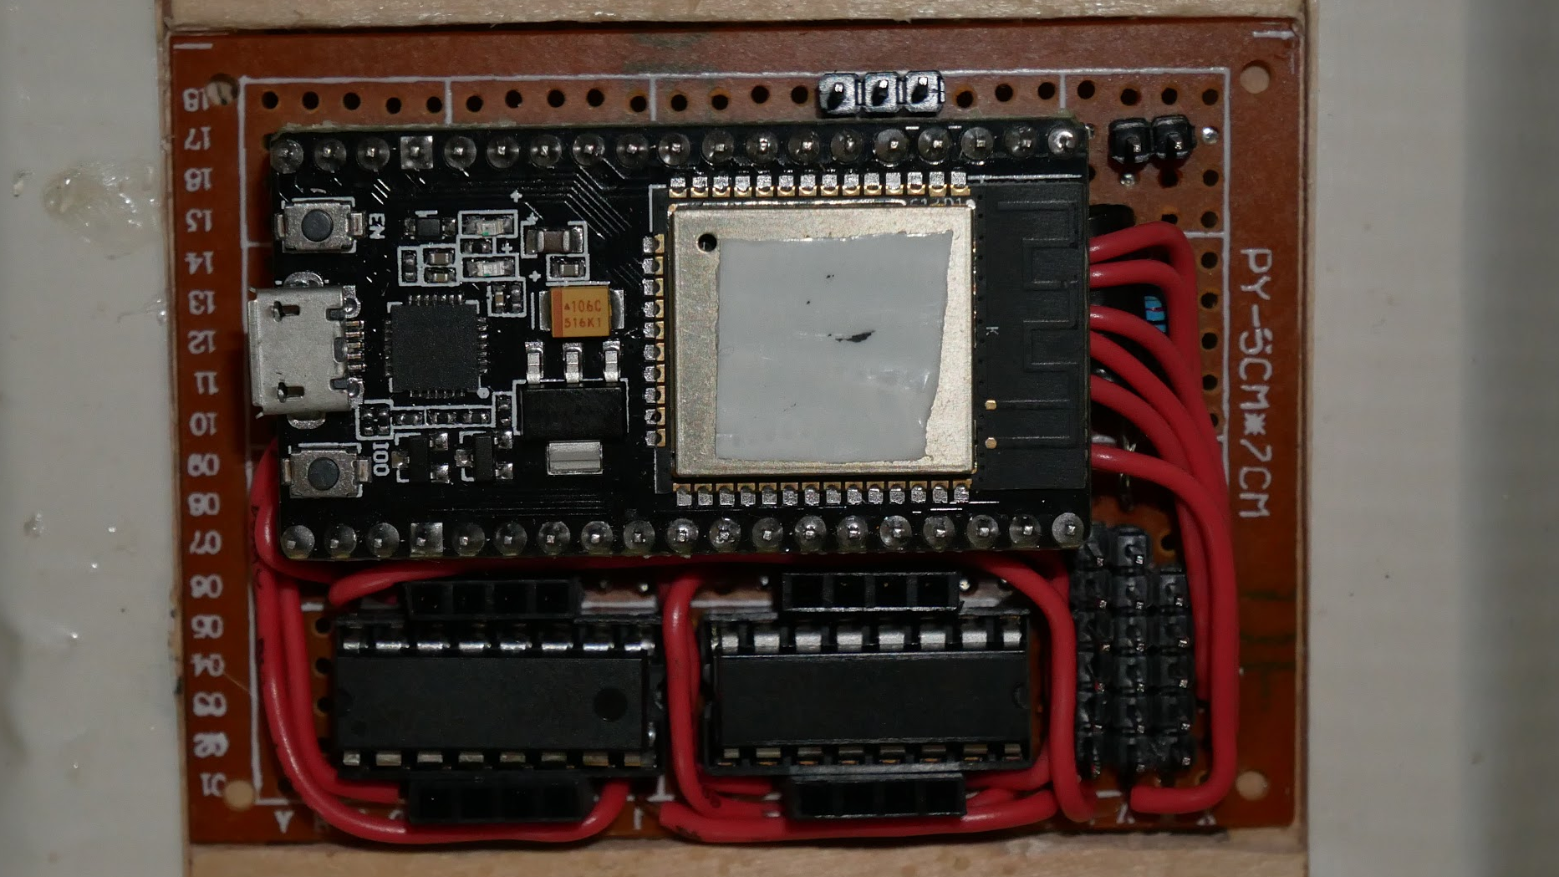
2 x 3 in
5 x 7.6 cm
5 rechargeable AA batteries
processor + wifi
5 servo ports
4 motor control channels
Notes:
The circuit board of an RCM is 2 by 3 inches.
An RCM uses an ESP32 microprocessor which has a built in wifi radio.
It includes two dual motor driver chips for 4 motor control channels.
And it can also control up to 5 small servo motors.
RCMs need power from 5 rechargeable double A batteries.

Slide 3
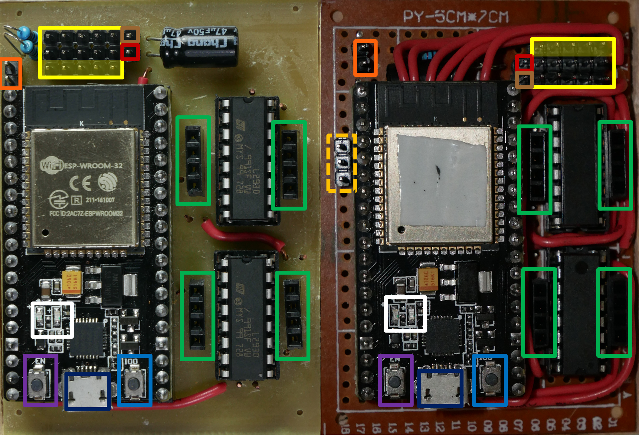
RCM user guide
Notes:
Please look at the RCM user guide document for more detailed information about all the ports on the board. Search for RCM user guide in the google folder that should be shared with everyone, or find the link in the robot help channel on slack.
We have made some RCMs with perfboards and others with custom circuit boards. The only big difference is that the circuit board ones were easier to make, though there are some differences in where ports are.

Slide 4
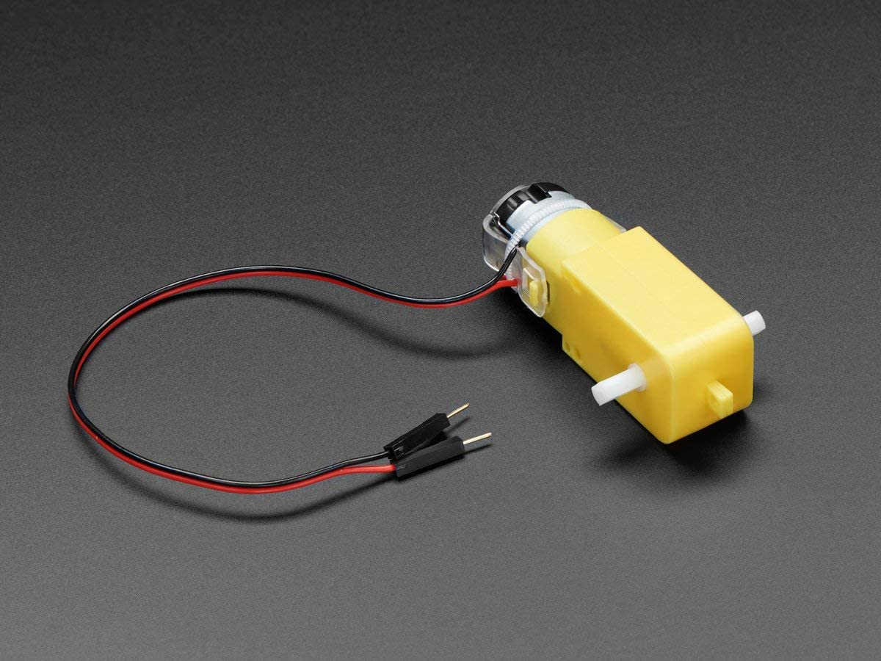
Motors
Image stolen from Adafruit.com
Notes:
The motor drivers in the RCM can only supply 600 milliamps. Small gearmotors work well.
You can connect two motors to one motor channel if you’re ok with them turning together and don’t need much power from them

Slide 5
Servos
Notes:
You can use normal servos that go to a signaled position for mechanisms like an arm or gripper. You can also use continuous rotation servos that spin at adjustable speeds and can replace gearmotors.

Slide 6
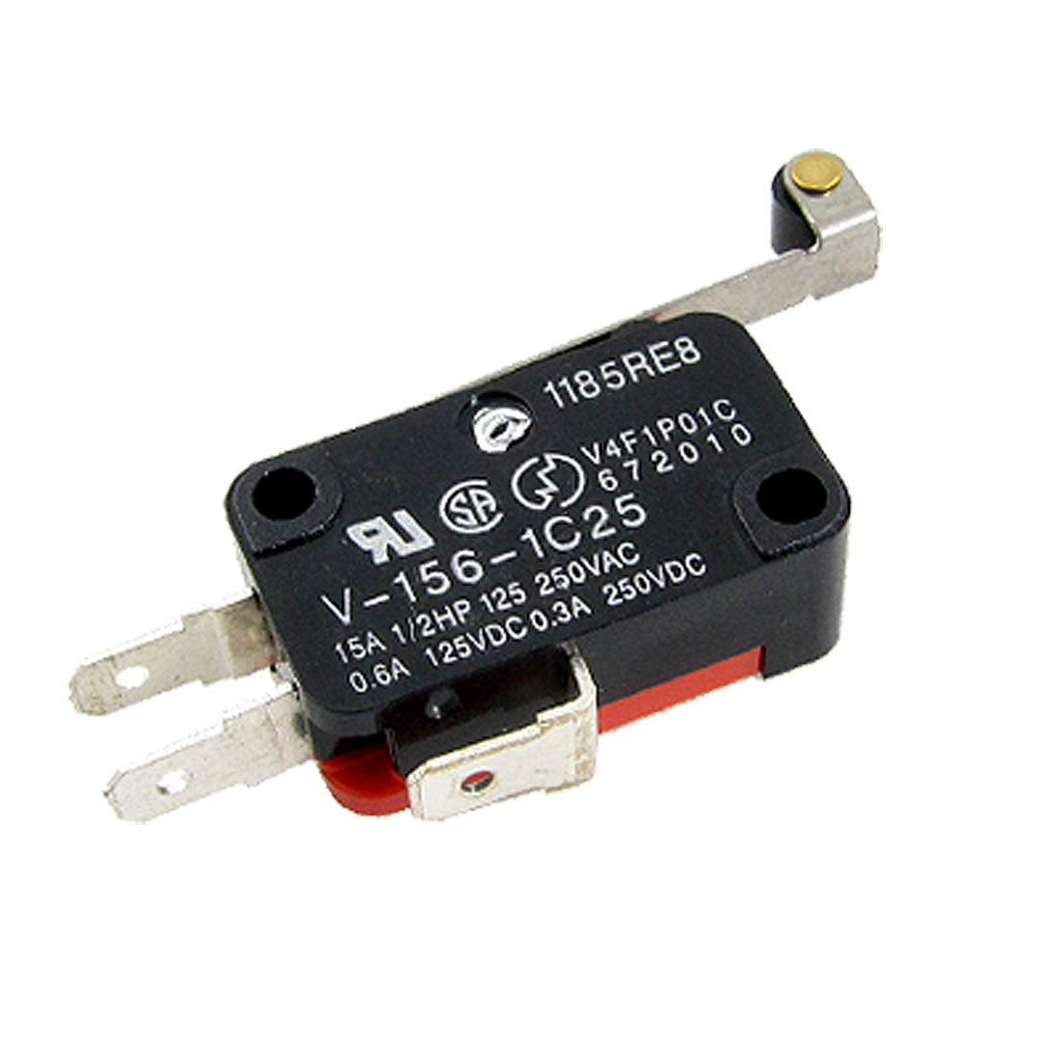
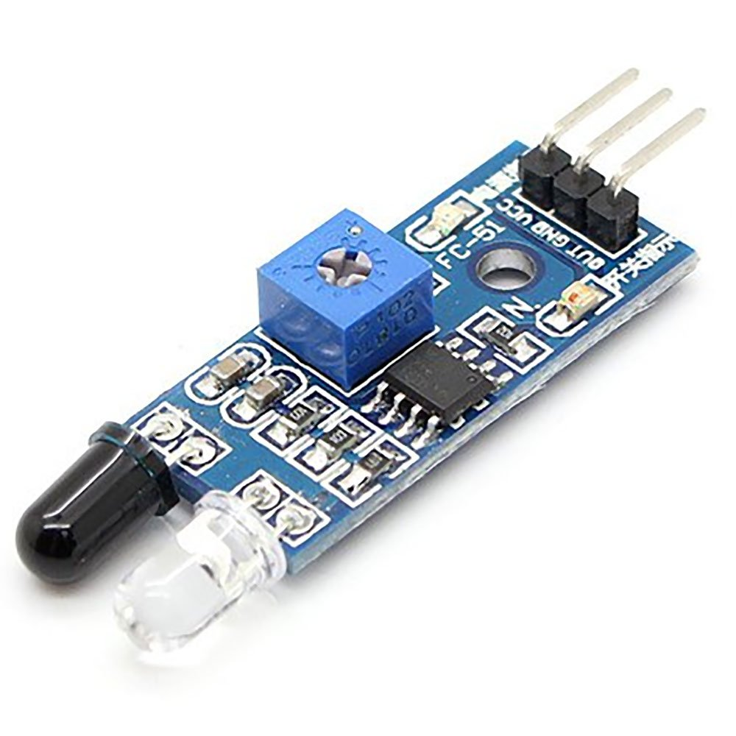
Other components
Notes:
You don’t have to stick to just motors and servos. Each servo port has a pin that instead of controlling a servo can be used as an input or output. Some RCM boards have 3 additional input only pins available.
Examples of other parts the RCM could be connected to include distance sensors, switches, and LEDs.

Slide 7

Programming the RCM
I’ve written support code to handle controlling motors and servos and sending information over wifi.
You just need to fill in a few lines of code to be able to control everything on your robot.
If you want to program more complex autonomous or semi-auto routines, you can.
The template code, and some example robot programs are on Github.
https://github.com/RCMgames/RCM
(also linked from the bottom of the RCM User Guide)

Slide 8
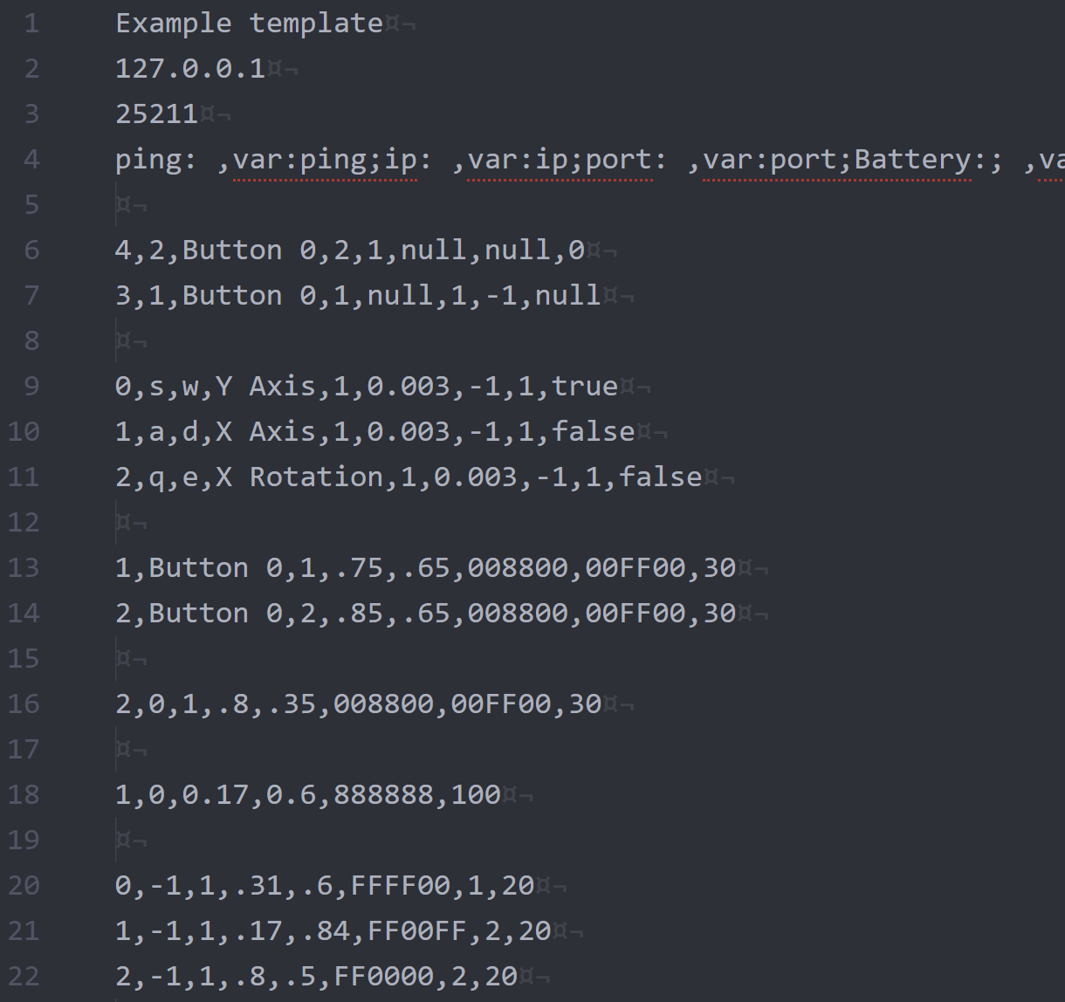
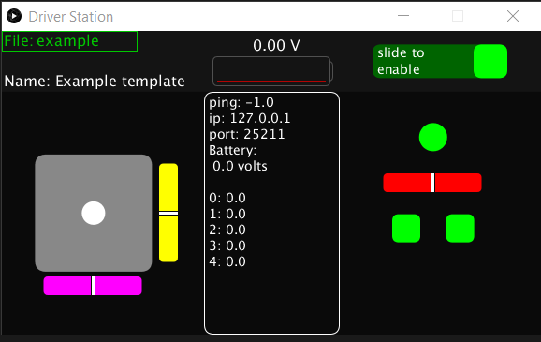
Configuring your driverstation
You’ll also need to set up a driverstation to control your robot. You can drive with your keyboard, mouse, or a gamepad.
Weston made a driverstation program that can be configured by editing a text file.
Ask Weston or me in #robot-help for help making a driverstation interface for your robot
https://github.com/RCMgames/RCMDS-new
(also linked from the bottom of the RCM User Guide)

Slide 9
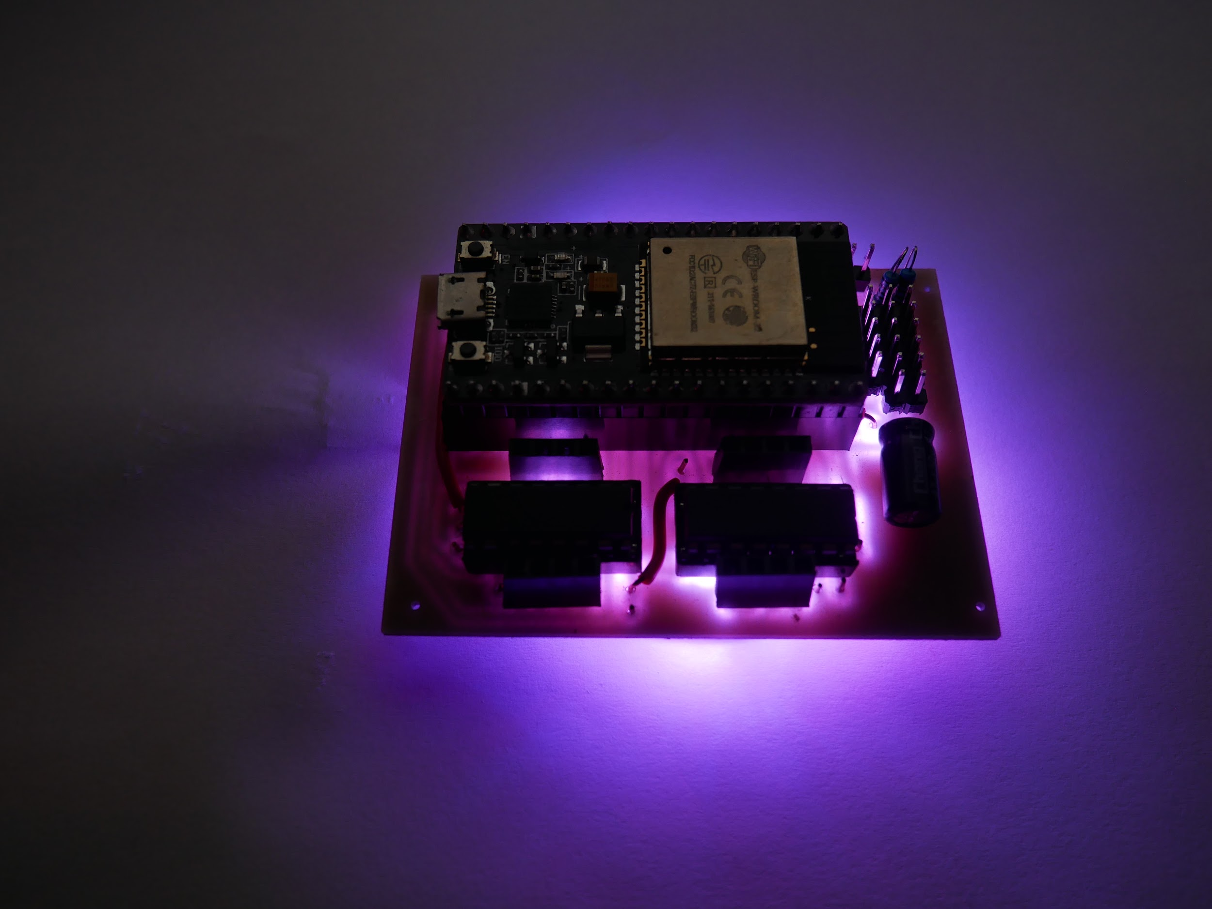
Questions?
If you have questions later, please post in #robot-help

